Slide 1

MongoDB Case study Review: Group 11
19CSE357 | BIGDATA ANALYTICS DIVESH KOSURI [CB.EN.U4CSE19422]

Slide 2
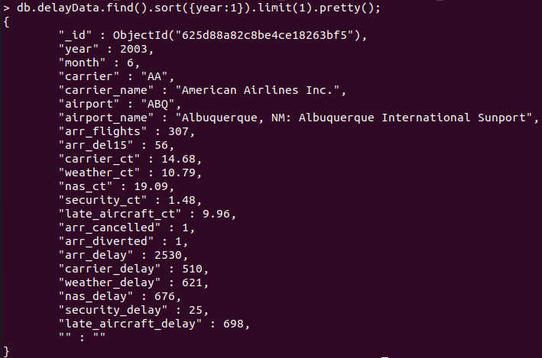
FINDING THE MINIMUM AND MAXIMUM YEAR RECORDED IN THE DATABASE
QUERY 1: db.delayData.find().sort({year:1}).limit(1).pretty();

Slide 3
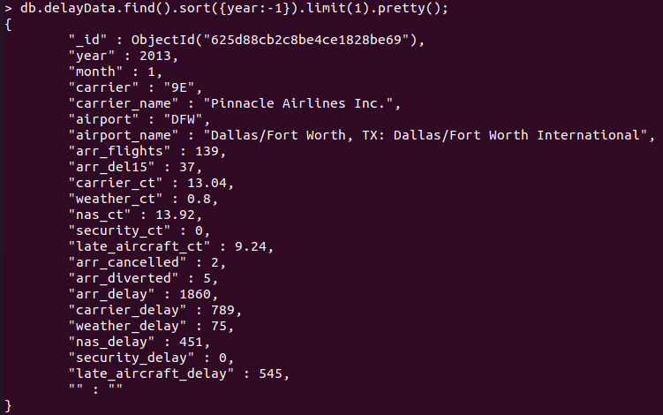
QUERY 2:
db.delayData.find().sort({year:-1}).limit(1).pretty();

Slide 4
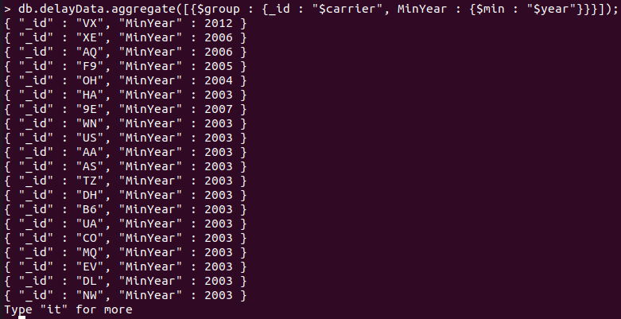
FINDING THE YEARS OF SERVICE [AGGREGATE FUNTIONS]
QUERY 3:
db.delayData.aggregate([{$group : {_id : “$carrier”, MinYear : {$min : “$year”}}}]);

Slide 5
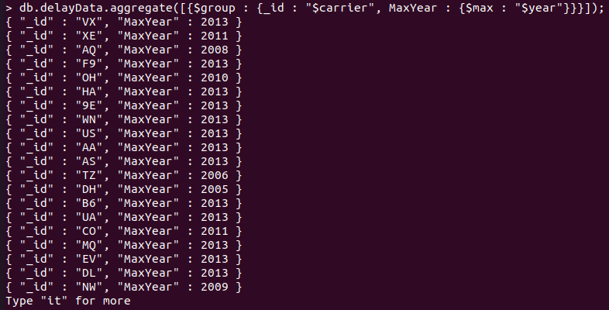
QUERY 4:
db.delayData.aggregate([{$group : {_id : "$carrier", MaxYear : {$max : "$year"}}}]);

Slide 6
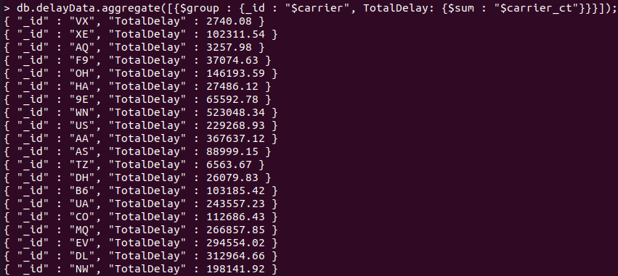
TO FIND THE TOTAL DELAY OCCURRED DUE TO CARRIER LOAD-UNLOAD
Query 5:
db.delayData.aggregate([{$group : {_id : "$carrier", TotalDelay: {$sum : "$carrier_ct"}}}]);

Slide 7
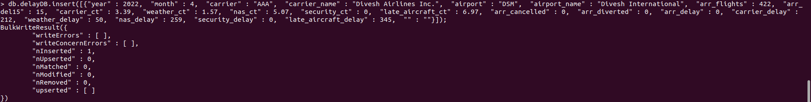
INSERTING NEW RECORD
QUERY 6: db.delayDB.insert([{"year" : 2022, "month" : 4, "carrier" : "AAA", "carrier_name" : "Divesh Airlines Inc.", "airport" : "DSM", "airport_name" : "Divesh International", "arr_flights" : 422, "arr_del15" : 15, "carrier_ct" : 3.39, "weather_ct" : 1.57, "nas_ct" : 5.07, "security_ct" : 0, "late_aircraft_ct" : 6.97, "arr_cancelled" : 0, "arr_diverted" : 0, "arr_delay" : 0, "carrier_delay" : 212, "weather_delay" : 50, "nas_delay" : 259, "security_delay" : 0, "late_aircraft_delay" : 345, "" : ""}]);

Slide 8
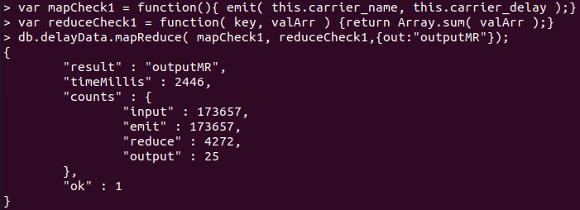
MAP-REDUCE QUERY 1
QUERY 7: Defining Mapper and Reducer
• var mapCheck1 = function(){ emit( this.carrier_name, this.carrier_delay );}
•var reduceCheck1 = function( key, valArr ) {return Array.sum( valArr );}
•db.delayData.mapReduce( mapCheck1, reduceCheck1,{out:"outputMR"});

Slide 9
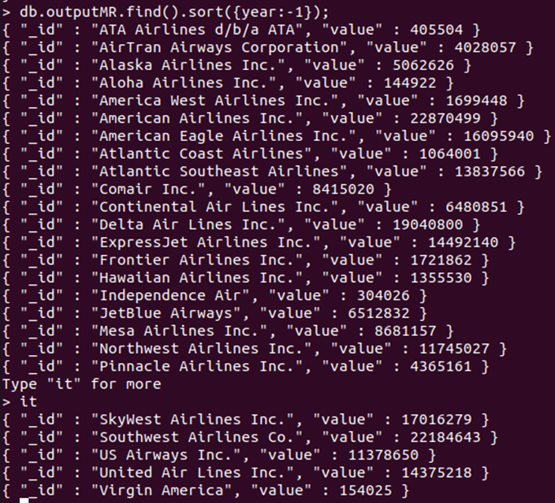
Loading Data
QUERY 8:
Loading the output with sorted order according to the requirement

Slide 10
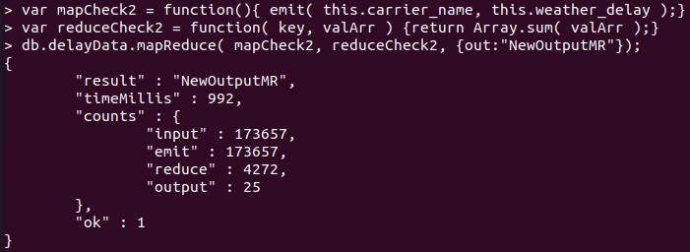
MAP-REDUCE QUERY 2
QUERY 9: Defining Mapper and Reducer
var mapCheck2 = function(){ emit( this.carrier_name, this.weather_delay );}
var reduceCheck2 = function( key, valArr ) {return Array.sum( valArr );}
db.delayData.mapReduce( mapCheck2, reduceCheck2, {out:"NewOutputMR"});

Slide 11
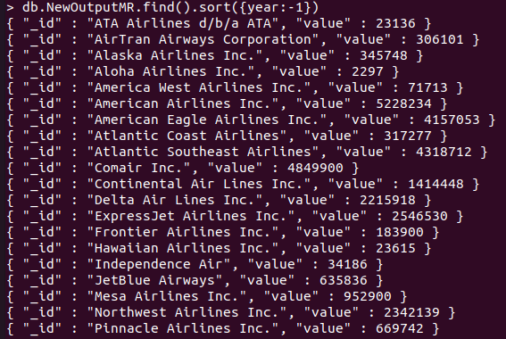
Loading Data
QUERY 10:
Loading the output with sorted order according to the requirement.

Slide 12
MongoDB Review
P KOUSHIK [CB.EN.U4CSE19449]

Slide 13
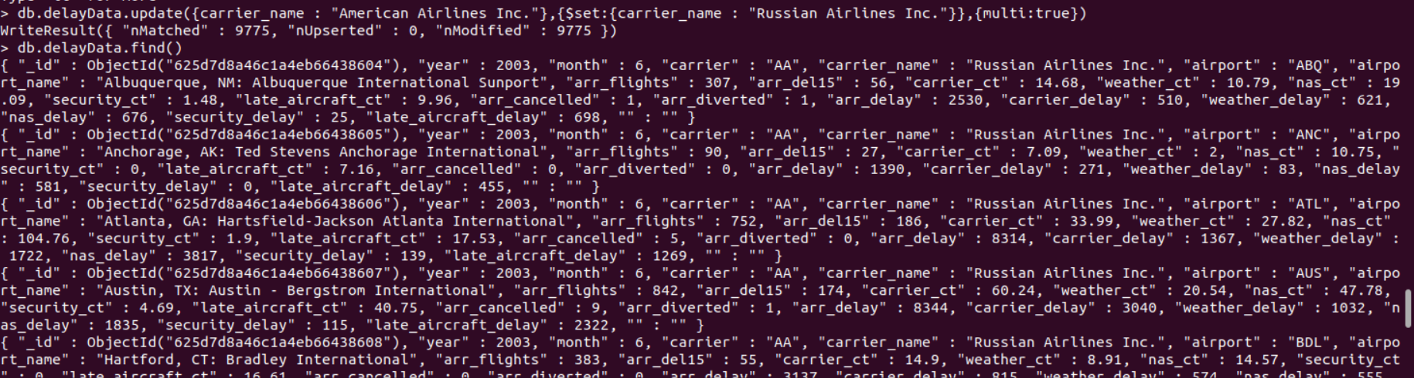
1. Updating the carrier name from the database.
db.delayData.update({carrier_name : "American Airlines Inc."},{$set:{carrier_name : "Russian Airlines Inc."}},{multi:true})

Slide 14
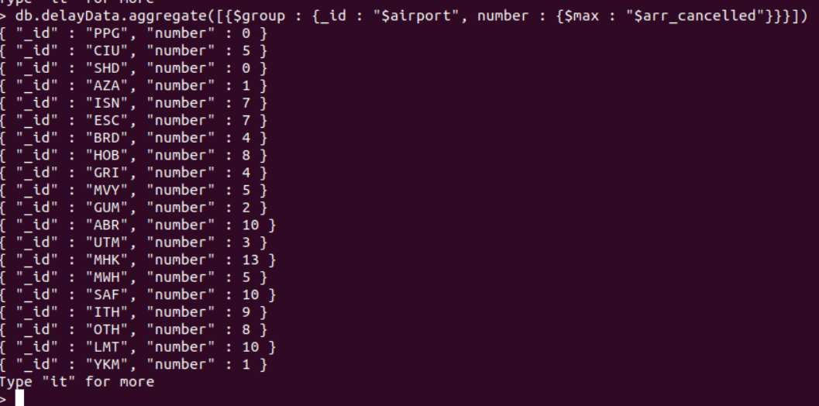
2. Finding the maximum number of flights cancelled for that airport
db.delayData.aggregate([{$group : {_id : "$airport", number : {$max : "$arr_cancelled"}}}])

Slide 15
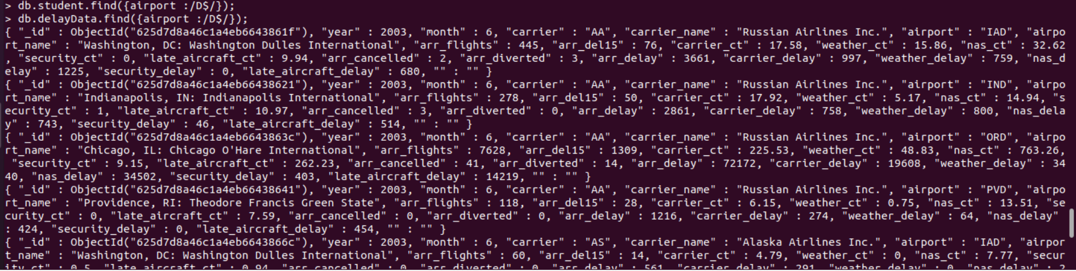
3. Finding the flights data which ends with a Strings
db.delayData.find({airport :/D$/});

Slide 16
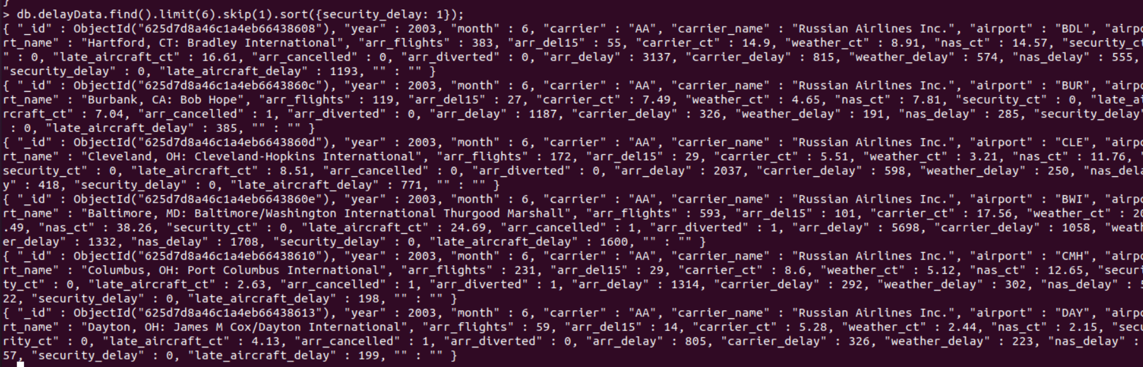
4. Skip:
db.delayData.find().limit(6).skip(1).sort({security_delay: 1});

Slide 17
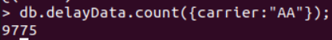
5. To find how many flights are there in carrier by using Count:
db.delayData.count({carrier:"AA"});

Slide 18
CASESTUDY: AIRPORTS ANALYTICS Analysis with MongoDB
19CSE357 | Group 11
BIGDATA ANALYTICS

Slide 19
RAVELLA ABHINAV
CB.EN.U4CSE19453

Slide 20
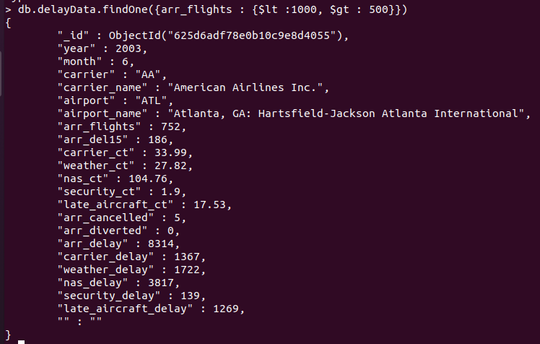
1. Find the airports that which flights count in between 500 and 1000?
Query:
db.delayData.find({arr_flights : {$lt :1000, $gt : 500}})
To find one document:
db.delayData.findOne({arr_flights : {$lt :1000, $gt : 500}})

Slide 21
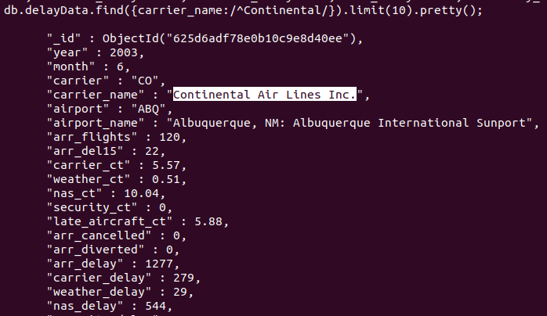
2. Find the airline name that starts with "Continental".
Query:
db.delayData.find({carrier_name:/^Continental/}).limit(10).pretty();

Slide 22
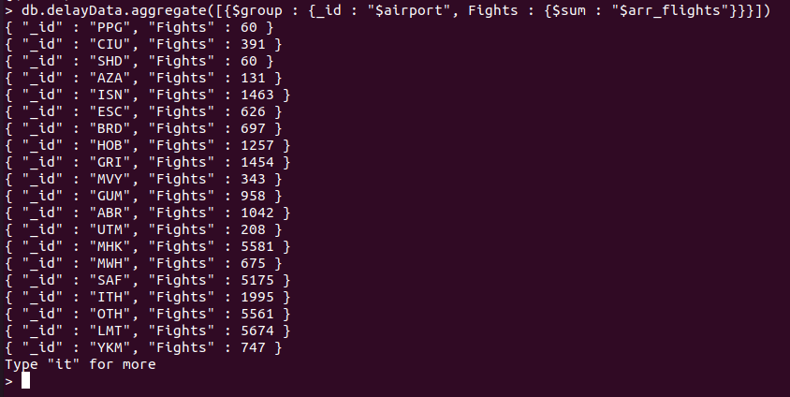
3. Find the count of flights that are arriving for airports.
Query:
db.delayData.aggregate([{$group : {_id : "$airport", Fights : {$sum : "$arr_flights"}}},{"$sort": {Flights: 1}}])

Slide 23
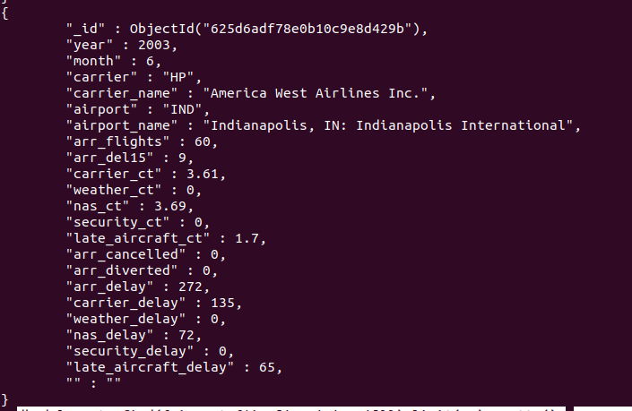
4. Find the carrier names that belongs to ANC and IND airports
Query:
db.delayData.find({airport:{$in:['ANC','IND']}}).limit(10).pretty();

Slide 24
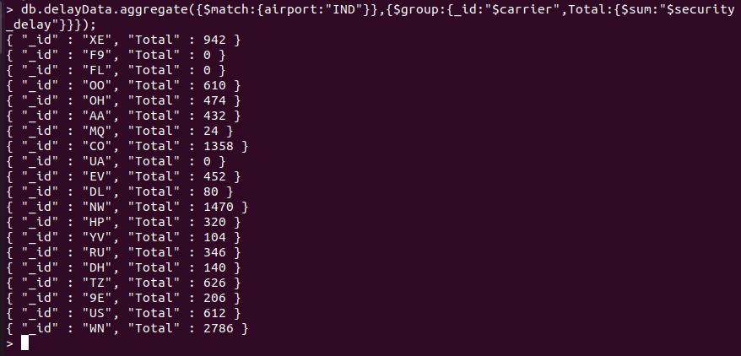
5. Find the total security of IND airport with airlines having security delays
Query:
db.delayData.aggregate({$match:{airport:"IND"}},{$group:{_id:"$carrier",Total:{$sum:"$security_delay"}}});

Slide 25
6. Find the number of flight diversions that occur in St Louis
var m1 = function(){ var rval = { airport: this.airport_name, year: this.year }; if( this.airport=="STL") { emit( rval, this.arr_diverted ); } };
var r1 = function( key, valArr ) { return Array.sum( valArr ); }
db.delayData.mapReduce( m1, r1, {out:'tmp'});
db.tmp.find().sort( {'_id.year':-1} )

Slide 26
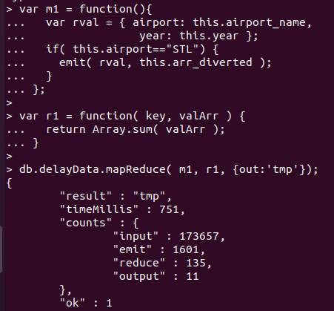
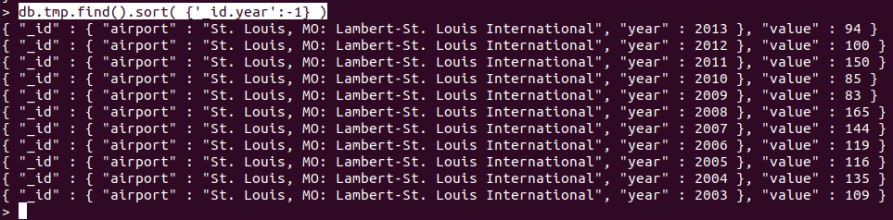
MapReduce Output

Slide 27

MongoDB
CB.EN.U4CSE19459
SHANTHAN REDDY

Slide 28
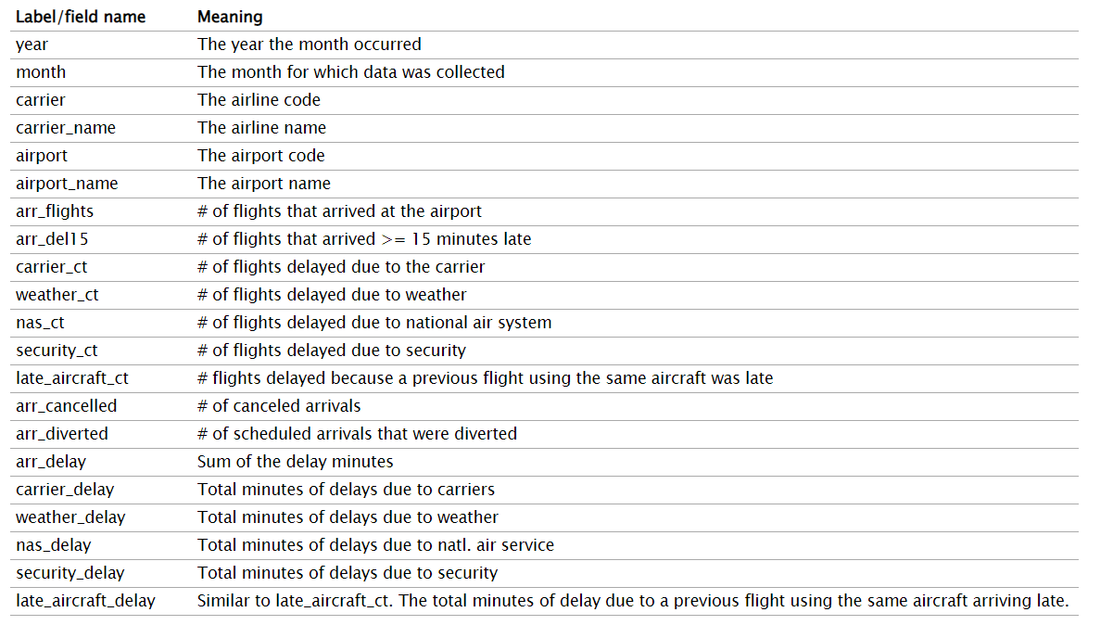
Dataset

Slide 29
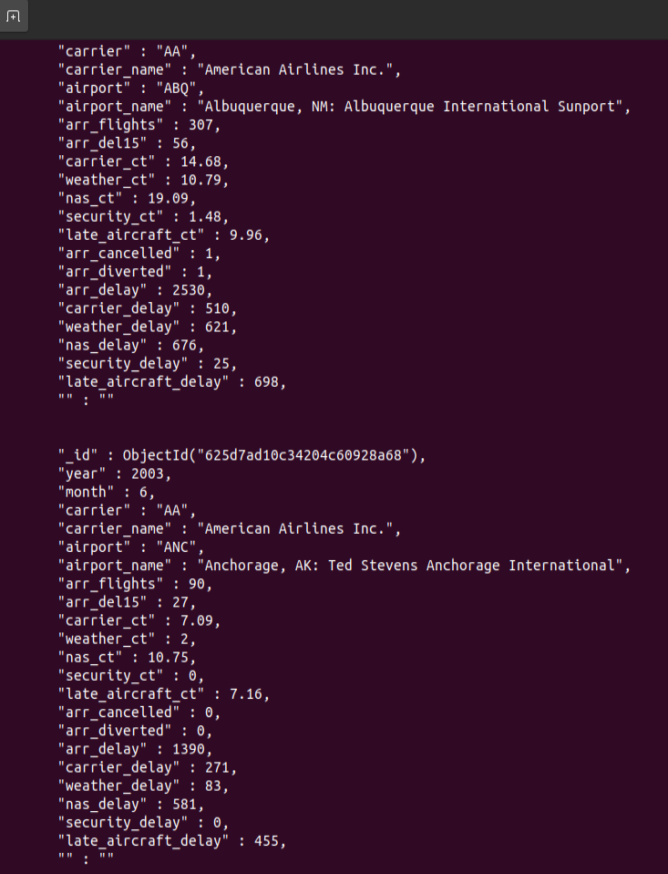
QUERY 1:
db.delayData.find({carrier_name:"American Airlines Inc."}).pretty();

Slide 30
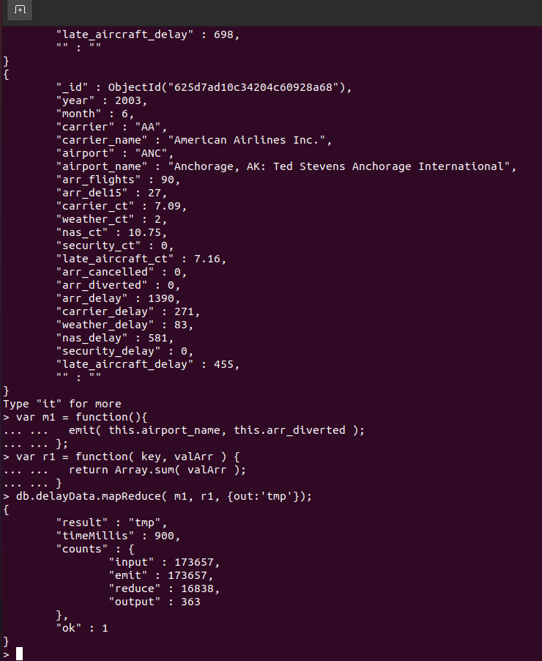
QUERY 2:
var m1 = function(){
... emit( this.airport_name, this.arr_diverted );
... };
var r1 = function( key, valArr ) {
... return Array.sum( valArr );
... }
db.delayData.mapReduce( m1, r1, {out:'tmp'});

Slide 31
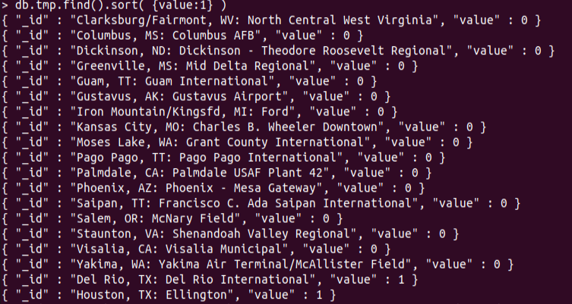
QUERY 3:
db.tmp.find().sort( {value:1} )

Slide 32
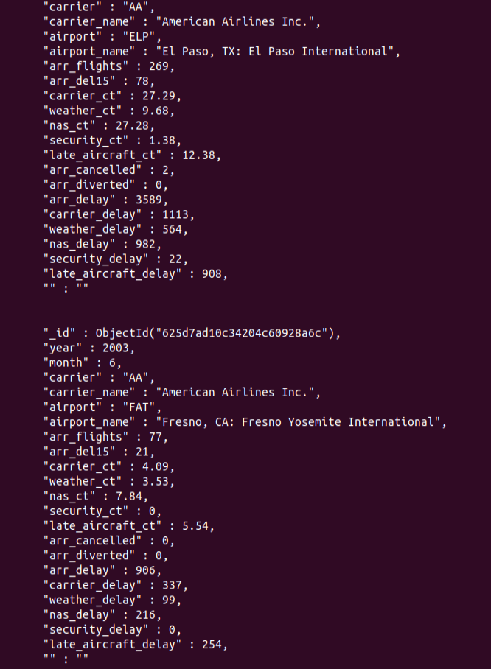
QUERY 4:
db.delayData.find({arr_cancelled:{$lte:5}}).pretty();

Slide 33
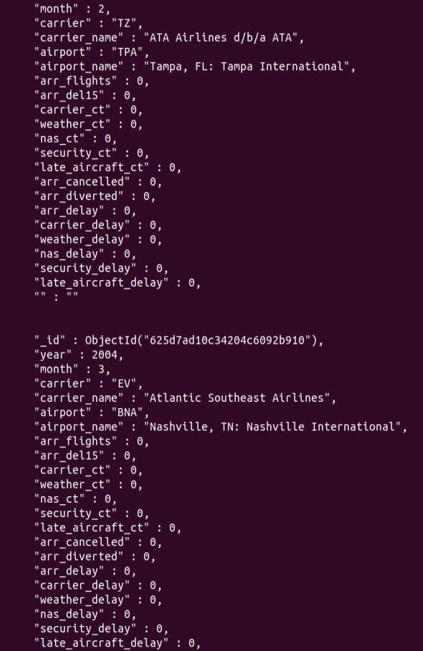
QUERY 5:
db.delayData.find().sort({arr_flights:1}).pretty().limit(10);

